Slide 1
Gaussian Filters
By Andrew Lo

Slide 2
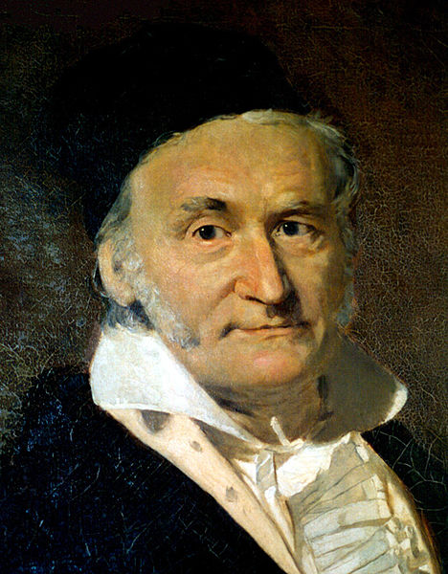
Johann Carl Friedrich Gauss
- German mathematician and physical scientist
- His field of contributions include statistics analysis, algebra, differential geometry, optics, and etc…
-Discovered the possibility of
Non-Euclidean geometries – known
as the Gaussian distribution. [1]

Slide 3
Applications
Smoothing image
Edge detection (not sensitive to noisy environments, whereas Laplacian is sensitive)
Laplacian of Gaussian filtering (smooth then sharp, similar to unsharp and highboost filtering)
Video games
Camera
Space Images

Slide 4
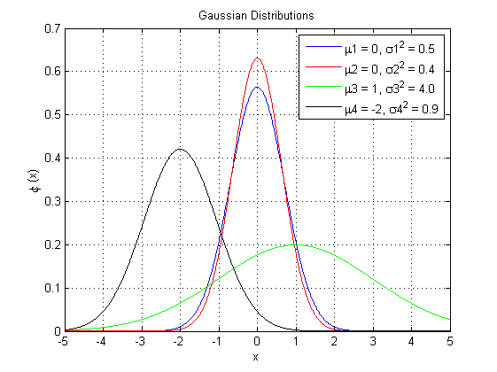
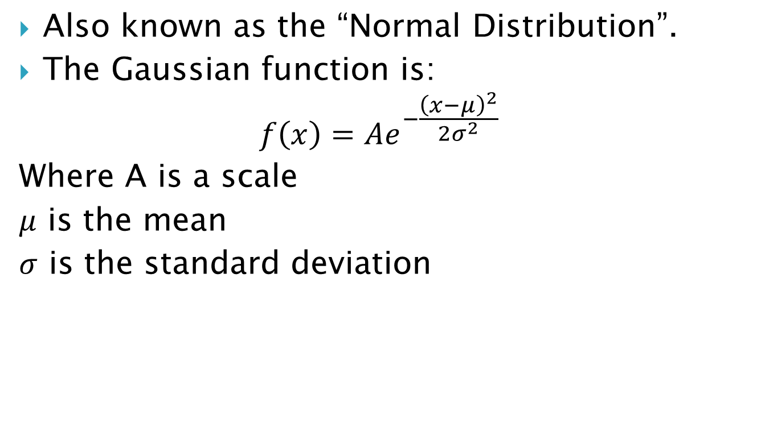
Gaussian Distribution
Also known as the “Normal Distribution”.
The Gaussian function is:
$$f\left(x\right)=Ae^{−\frac{{\left(x−μ\right)}^{2}}{2σ^{2}}}$$
Where A is a scale
$μ$ is the mean
$σ$ is the standard deviation
Notes:
Mu and sigma

Slide 5
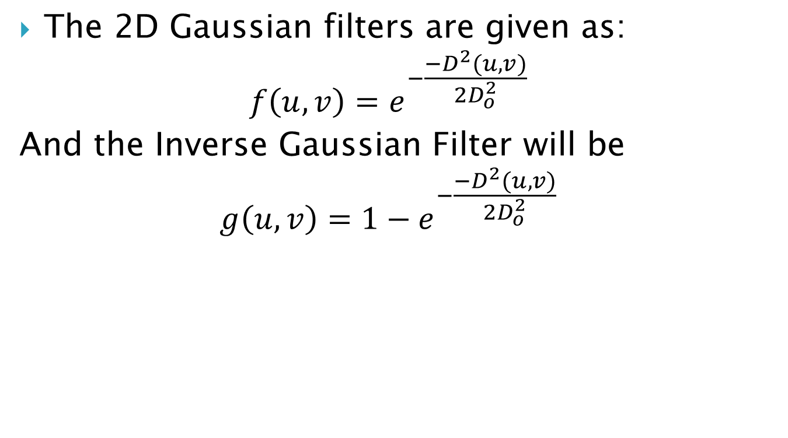
Gaussian Filters
The 2D Gaussian filters are given as:
$$f\left(u,v\right)=e^{−\frac{{−D}^{2}(u,v)}{2D_{o}^{2}}}$$
And the Inverse Gaussian Filter will be
$$g\left(u,v\right)=1−e^{−\frac{{−D}^{2}(u,v)}{2D_{o}^{2}}}$$

Slide 6
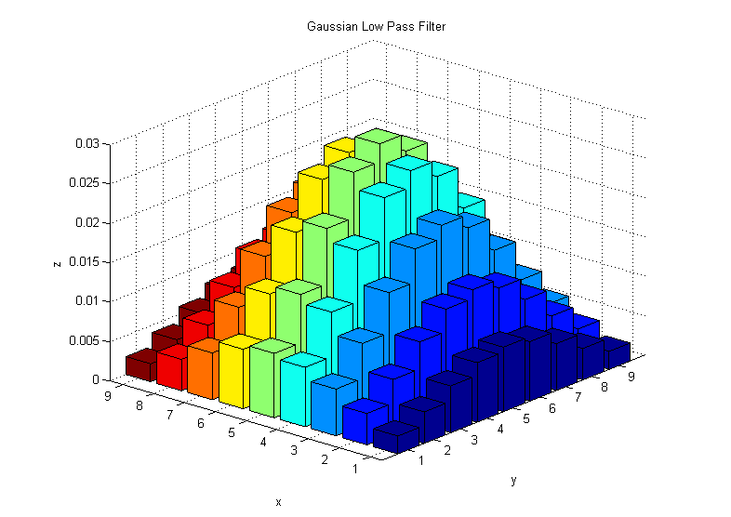
Gaussian Filter

Slide 7
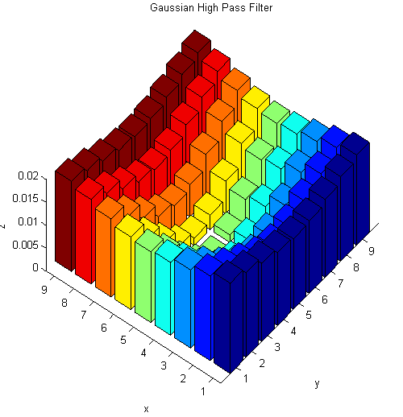
Inverse Gaussian Filter

Slide 8
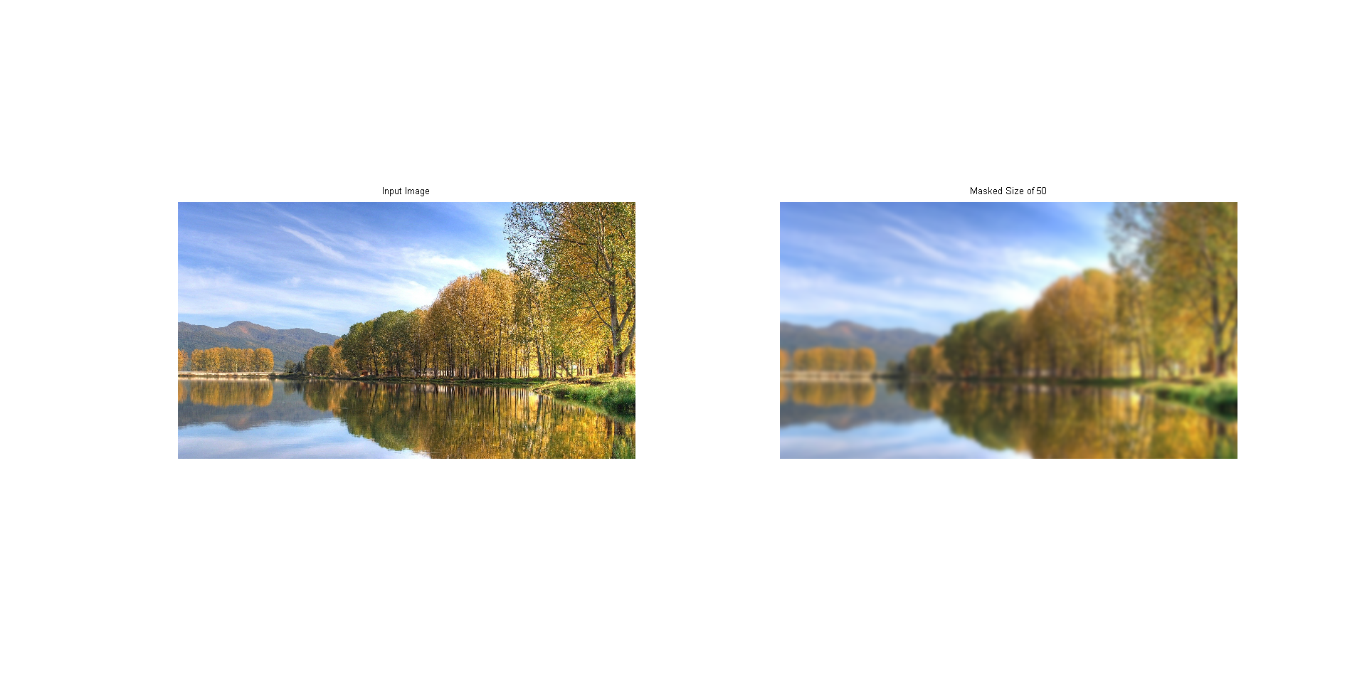
In Spatial Domain
Easy to implement
Blurs the image

Slide 9
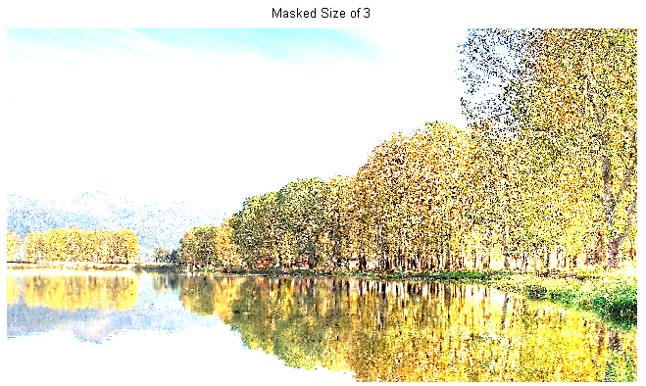
In Spatial Domain
Inverse is a lot harder to implement in spatial domain. Below is my attempt:
inverseMask= max(max(Mask))-Mask;

Slide 10
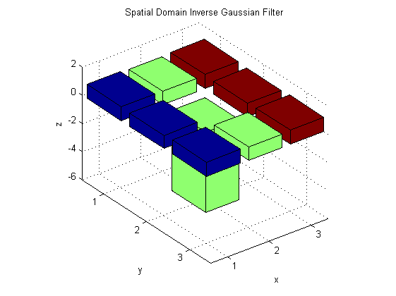
Why?
Notice the 8-neighbour pixels are almost the same and the center pixel is really small.
Notes:
Due to the nature of Gaussian distribution!

Slide 11
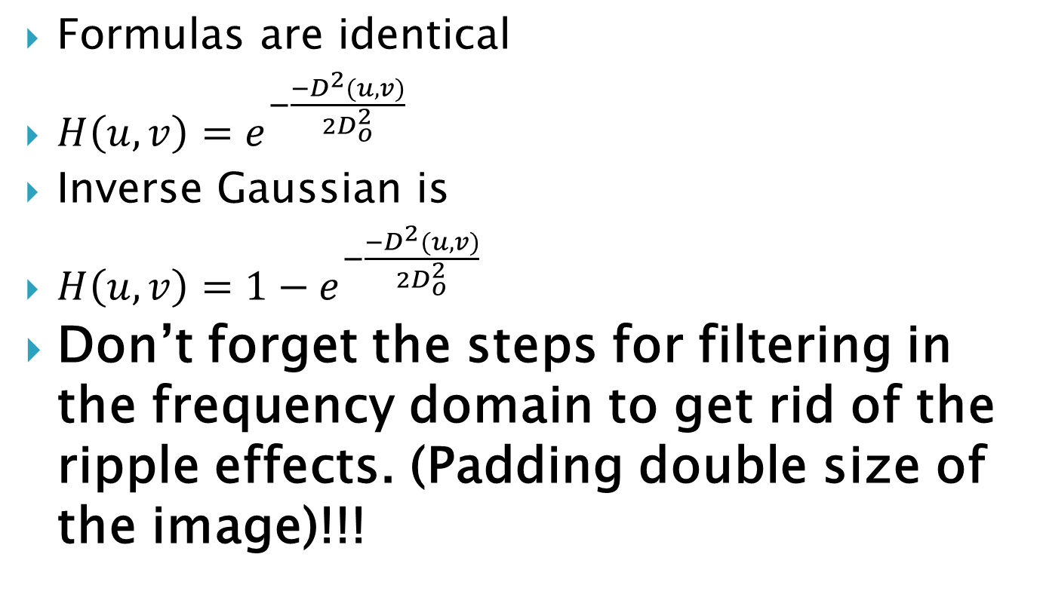
In Frequency Domain
Formulas are identical
$H\left(u,v\right)=e^{−\frac{{−D}^{2}(u,v)}{2D_{o}^{2}}}$
Inverse Gaussian is
$H\left(u,v\right)=1−e^{−\frac{{−D}^{2}(u,v)}{2D_{o}^{2}}}$
Don’t forget the steps for filtering in the frequency domain to get rid of the ripple effects. (Padding double size of the image)!!!

Slide 12
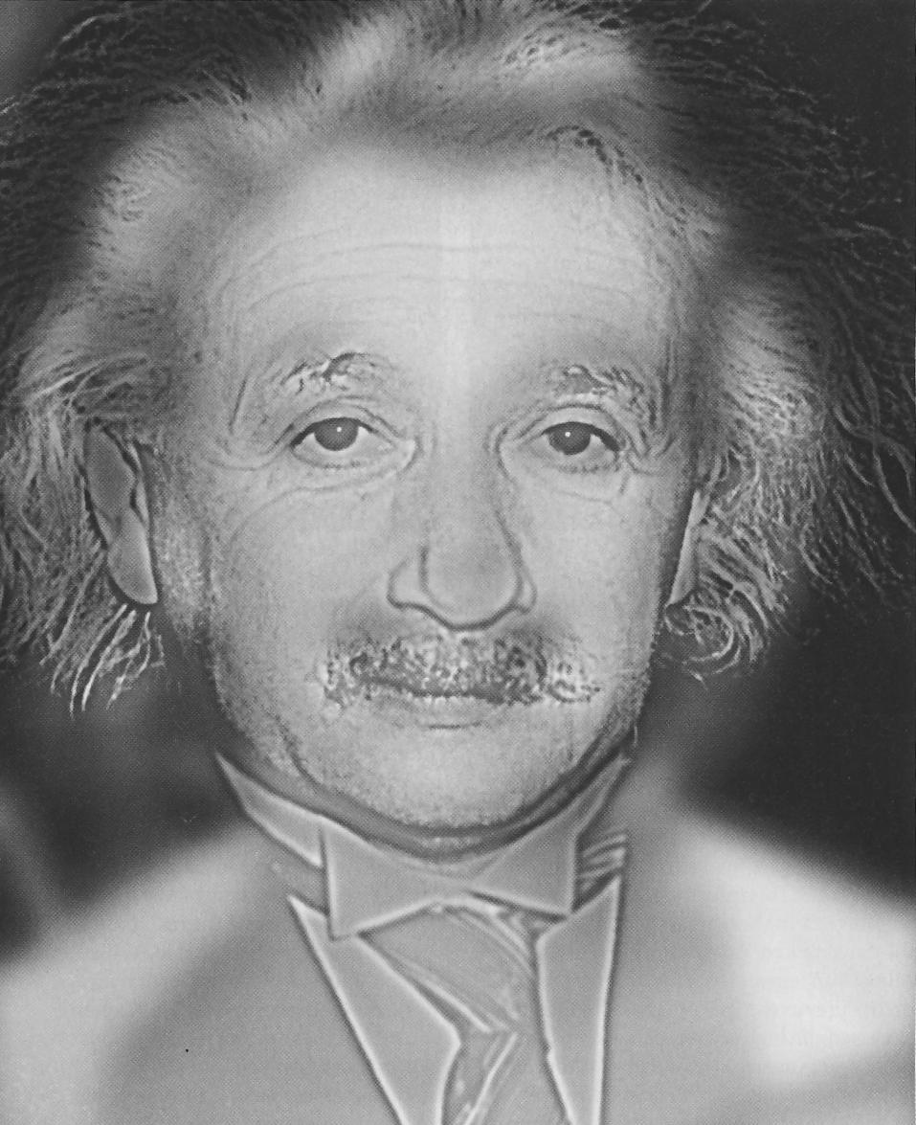
In Frequency Domain
Lets Analyze this image.
Is it Albert Einstein
or is it Marilyn Monroe

Slide 13
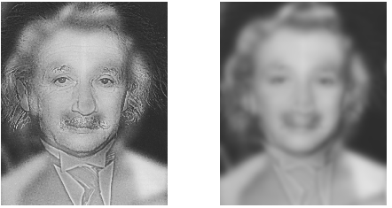
In Frequency Domain
Gaussian Filter

Slide 14
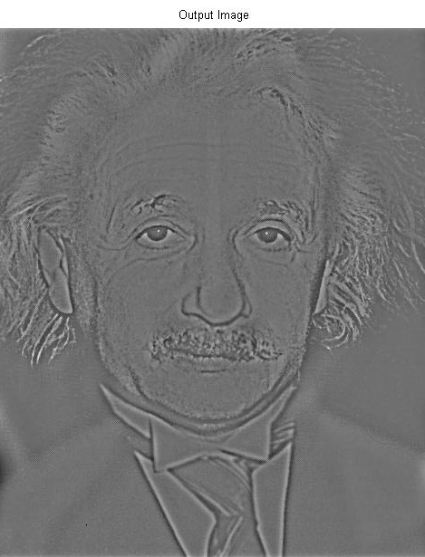
In Frequency Domain
Inverse Gaussian Filtr

Slide 15
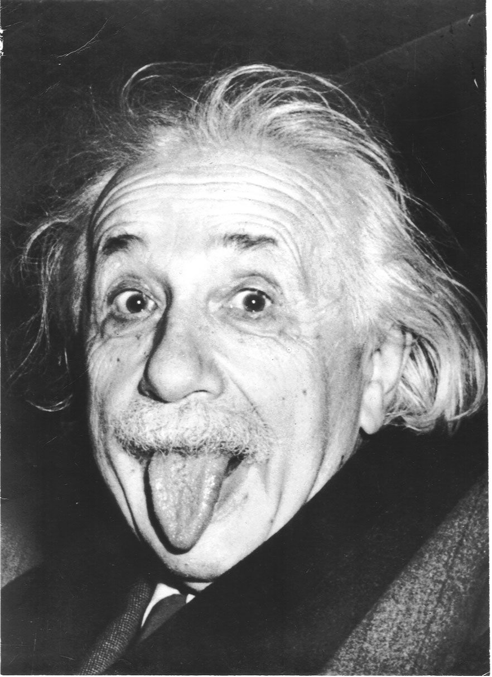
In Frequency Domain
The answer is that they used a blurred image of Marilyn Monroe and mixed a high pass filtered Albert Einstein image.

Slide 16
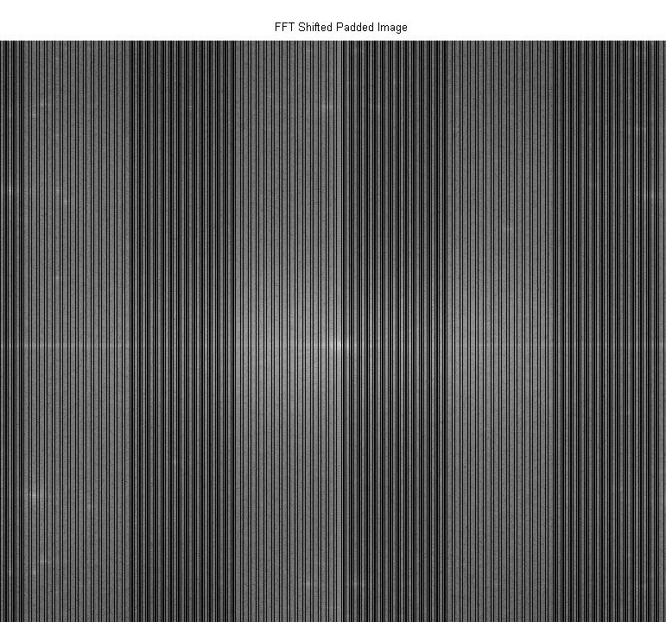
In Frequency Domain
Also look at the transformed image.
Notes:
Notice the 2 obvious frequency components)

Slide 17
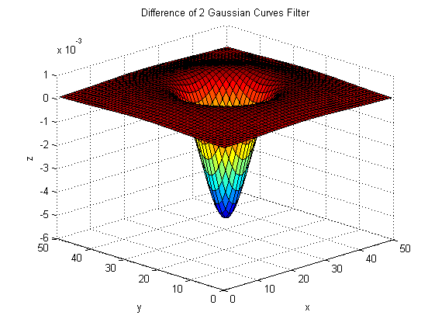
Difference Gaussian Filter
Basically is a filter of difference of two Gaussian curves.
Interesting Effects

Slide 18
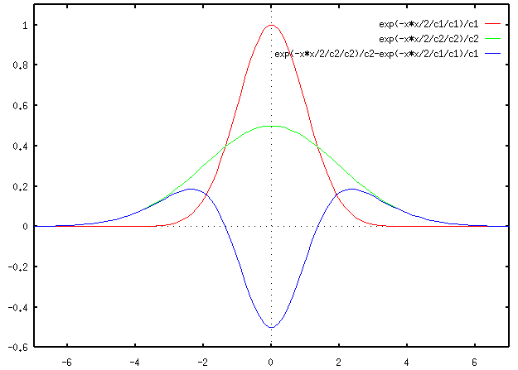
Difference Gaussian Filter

Slide 19
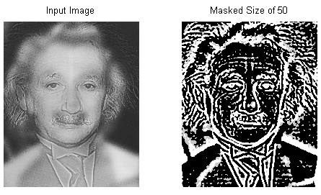
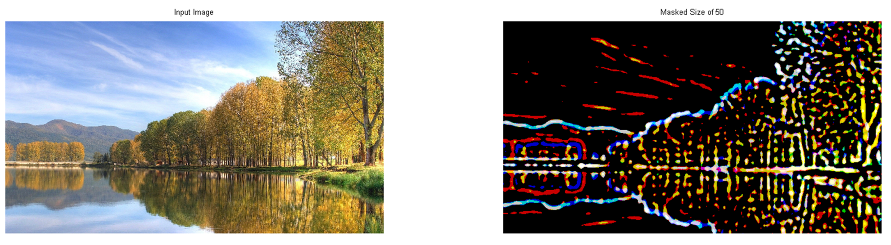
Difference Gaussian Filter
Edge detecction
This is done in spatial domain
In frequency domain, the effect will act like a mix of high/band pass filter

Slide 20
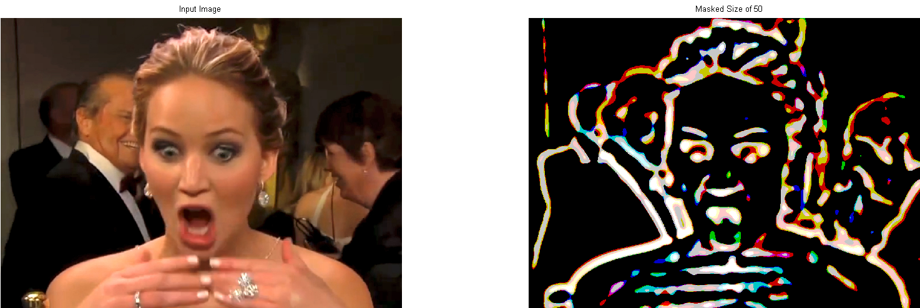
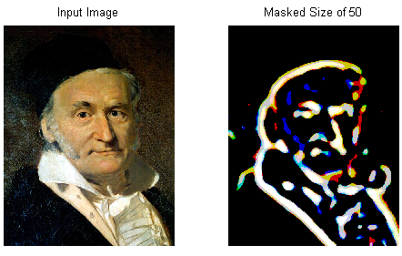
Difference Gaussian Filter

Slide 21
References
[1] Steven G. Krantz (1 April 2010). An Episodic History of Mathematics: Mathematical Culture through Problem Solving. MAA. pp. 171–. ISBN 978-0-88385-766-3. Retrieved 1 April 2013.
[2] Rafael C., Woods, Richard E. (2008). Digital Image Processing. Pearson Education, Inc. pp.270-286. ISBN 978-0-13168-728-8.
[3] Kyan M. (2013). ELE882_W2013_L06_FilteringInTheFrequencyDomain.pdf . https://courses.ryerson.ca/bbcswebdav/pid-2212614-dt-content-rid-3370600_2/courses/ele882_w13_01/ELE882_W2013_L06_FilteringInTheFrequencyDomain.pdf Retrieved 1 April 2013.

